Slide 1

Non-Invasive point of care ECG signal detection and analytics for cardiac diseases
Bachelor of Technology
for the course
CL 498 Project I
Presented By
Shubham Kumar Gupta
Roll No. 180107058
Under supervision of
Assistant Professor Resmi Suresh
Professor Dipankar Bandyopadhyay

Slide 2
Content
Objective
Heart’s Medical Background
Electrocardiogram (ECG)
Working Principle of ECG
Case Study
Dataset Refining
Dataset Modelling
Results and Discussion
Conclusion
References

Slide 3
Objective
Acquire information about the ECG and its operation
Analyze different product in the market, and to analyze what issues remain and how we may come up with a better solution with some enhancement.
Finalize limitations and constraints seeing Apple's ECG watch and Sanket's 12 Lead ECG
Develop our portable, noninvasive point-of-care system for monitoring ECG levels
Work on sample dataset, predict variety of diseases related to the heart especially Atrial Fibrillation
Collect our own datasets.
Two way communication between device and smartphone
Cloud Analysis

Slide 4
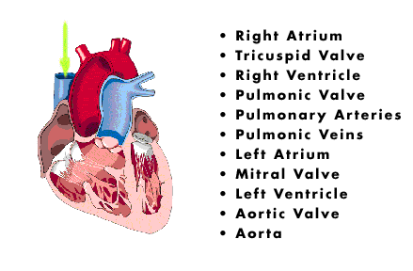

Heart’s Medical Background
The heart is placed in the center of our chest and has 4 chambers, 2 upper (atria) and 2 lower (ventricles).
Blood is pumped from right and left side. Right side pumps deoxygenated blood into pulmonary circulation, while left side oxygenates blood into systemic circulation. ​
Blood enters right atrium, then to right ventricle. Tricuspid valve prevents backward flow. Right ventricle pumps blood into pulmonary artery via pulmonary valve. ​
Pulmonary artery delivers deoxygenated blood to lungs, where gas exchange occurs. ​
Oxygenated blood returns to left side of heart via pulmonary veins and enters left atrium. ​
Left atrium pumps blood into left ventricle. Mitral valve prevents blood from flowing backward. Left ventricle pumps blood into aorta.​
Movement of blood
Source:springer.com
Aortic Valve
Source: myheart.net

Slide 5
Heart’s Medical Background
Muscular walls in each chamber of heart contract in a coordinated sequence
When an individual's heart rhythm is aberrant, this is called abnormal cardiac rhythms. It occurs when an individual's heart electrical system malfunctions or fails to perform properly.
Arrhythmias caused by irritable cardiac cells, blocked signals, aberrant routes, medications and stimulants, and coronary arteries spasms.
When heart rate is excessively rapid (tachycardia) or sluggish (bradycardia) that cardiac rhythm is considered abnormal.
People are unaware of irregular cardiac rhythms, they frequently only feel their repercussions, such as weakness or fainting.

Slide 6
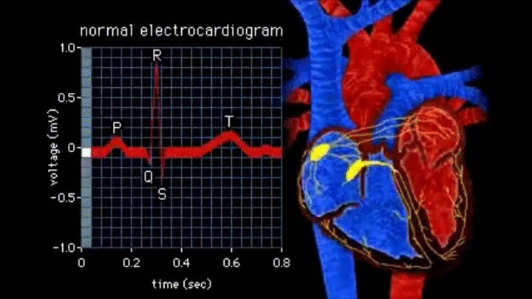
Electrocardiogram (ECG)
In 1983, Willem Einthoven was the first person to utilize an electrocardiogram.
Electrocardiogram records electrical signals in heart. Common and painless test to quickly detect heart problems.
Using electrodes, ECG records heart's electrical activity by putting electrodes (up to 10 electrodes) at various points on the body.
Electrocardiogram can be used to detect:
Abnormal heart rhythm (arrhythmias)
If blocked or narrowed arteries
Proper check on working of pacemaker
ECG is plotted on a graph paper in which 1mm corresponds to 0.04s on the x-axis and 0.1mV on the y-axis
ECG Recording

Slide 7
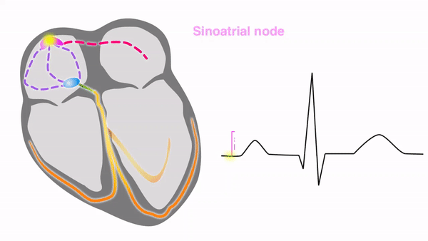
Electrocardiogram (ECG)
SA Node to Atria​
Electrical discharge for cardiac cycle starts in special area of right atrium called ‘sinoatrial (SA) node’​ (natural pacemaker).
It initiates all heartbeat and determines heart rate. Impulses from SA node spread throughout both internodal atrial pathway via atria and stimulate them to contract.​
Depolarization then spreads through atrial muscle fibers. ​
AV Node to Bundles​
There is a delay while depolarization spreads through another special area in atrium, ‘atrioventricular (AV) node’. ​
Located near AV valve. It passes signals onto bundle of His.​
This bundle is divided into right and left bundle branches which conduct impulses toward apex of heart. ​
Bundles to Purkinje fiber​
Signals are then passed onto Purkinje fibers, turning upward and spreading throughout ventricular myocardium.​
Repolarization occurs​
Path Tracing of an ECG
Source: sciencedirect.com

Slide 8
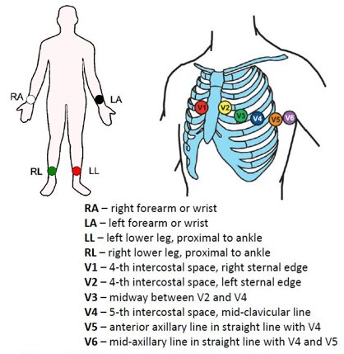
Electrocardiogram (ECG)
To take ECG with 12 leads electrodes are placed over body​
It uses only 10 electrodes, some electrodes are part of two pairs and provide two leads. ​
Electrodes typically are self-adhesive pads with a conducting gel in the center. The electrodes snap onto the cables connected to the electrocardiograph or heart monitor.​
E.C.G Gel will improve conductivity between the skin and the heart rate monitor electrodes . ​
Unipolar Leads (single conductor lead)​
Augmented Limb Leads (aVL, aVF, aVR) one limb is +ve and other two as zero.
Chest Leads are +ve poles
Bipolar Leads (2 separate conductors within a single-lead)​
Leads I, II, and III measure electrical potential between 2 of the 3 limb electrodes:​
12 Leads ECG electrode placement
Source:aimcardio.com

Slide 9
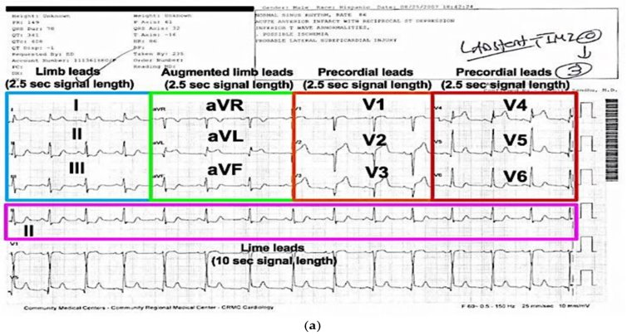
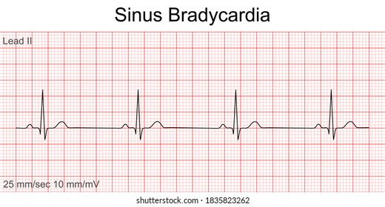
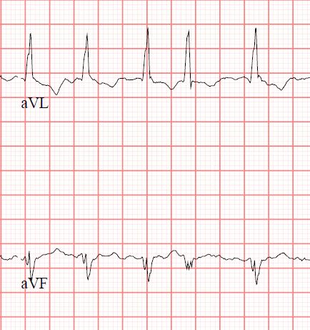
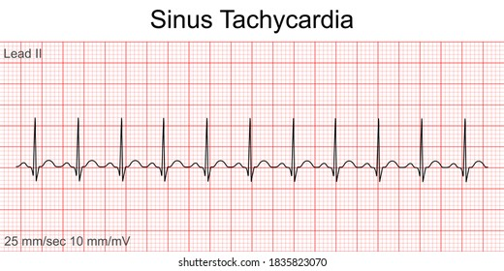
Electrocardiogram (ECG)
Tachycardia
Source:heart.org
Atrial Fibrillation
Source:heart.org
Sample ECG Recording
Source: oxfordmedicaleducation.com
Bradycardia
Source:heart.org

Slide 10
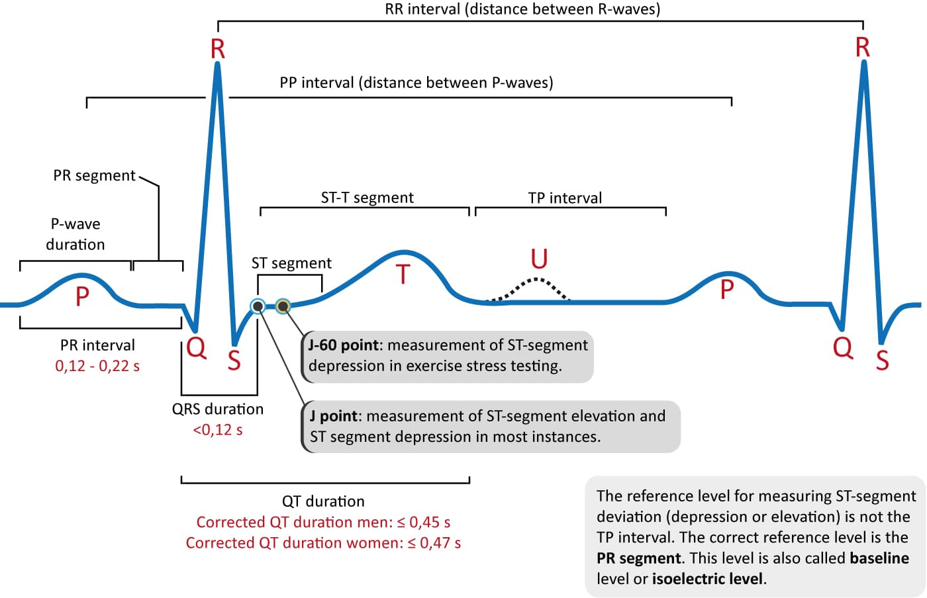
Electrocardiogram (ECG)
ECG waves and intervals are classified as
P-wave and PR interval
P wave is indicative of atrial depolarization (activation).
PR interval is time period between P-wave and QRS complex, used to assess normality of impulse conduction from atria to ventricles.
QRS Complex
It shows ventricles depolarizing and reflection of left ventricular depolarization because electrical vector generated by left ventricle that is bigger than electrical vector generated by right ventricle.
J-wave and ST segment
ST segment is particularly relevant in acute myocardial ischemia because ischemia results in deviation.
J point denotes commencement of ST segment.
T-wave and U-wave
T-wave indicates contractile cells' rapid repolarization and occur under wide variety of situations.
U-wave is +ve wave that occurs immediately following T-wave, about ¼th that of T-wave.
ECG wave segments
Source: ecgwaves.com

Slide 11
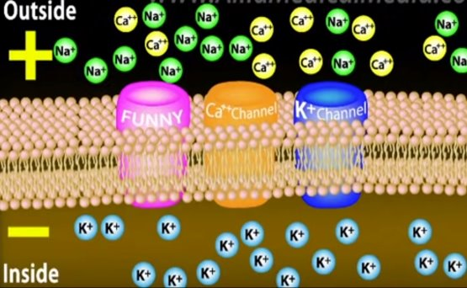
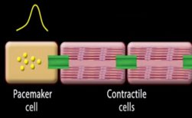
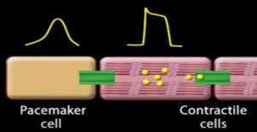
Working Principle
Pacemaker cells and contractile myocytes exhibit different forms of action potentials. Cells are polarized, meaning there is an electrical voltage across the membrane. ​
“Funny" because it has effects opposite to those of most other heart currents.​
In a resting cell, membrane voltage, known as resting membrane potential, is usually negative. This means cell is more negative on inside. ​
At resting state, there are concentration gradients of several ions across membrane: more Na+ and Ca2+ outside, and more K+ inside the cell​
Gradients are maintained by several pumps that bring Na+ and Ca2+ out, and K+ in.​
These channels are passageways for ions in and out of the cell, and are regulated by membrane voltage.
Mechanism of depolarization and repolarization in myocardium cells​
Movement of Ions in Channels from Pacemaker Cells
Souurce:oxfordmedicaleducation.com

Slide 12
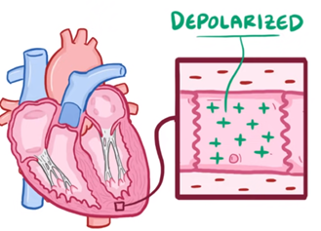
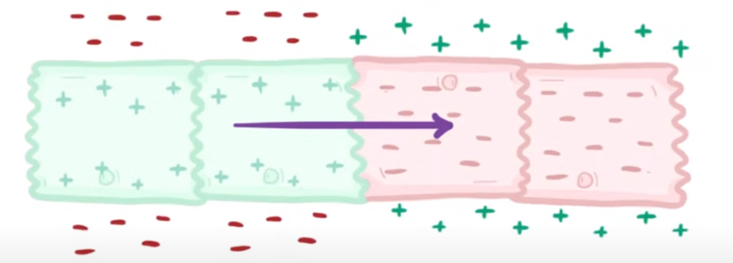
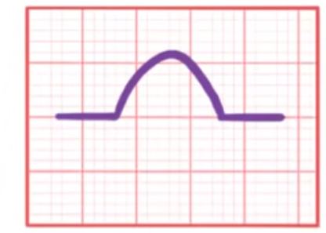


Working Principle
At rest, cells are –vely charged relative to +ve outside environment and when they depolarize, cells become +vely charged, making outside environment -ve.
Depolarization is passage of electrical current sequentially through heart muscle, changing it, cell by cell, from resting polarized state to depolarized state until entire heart is depolarized
If freezed this “wave of depolarization” moving through cells, there’s a difference of charge across this set of cells.
Charge difference creates a dipole. The electrodes detect charge on the outside of cell, so this points toward where +ve charge is outside and ECG shows a +ve deflection

Slide 13
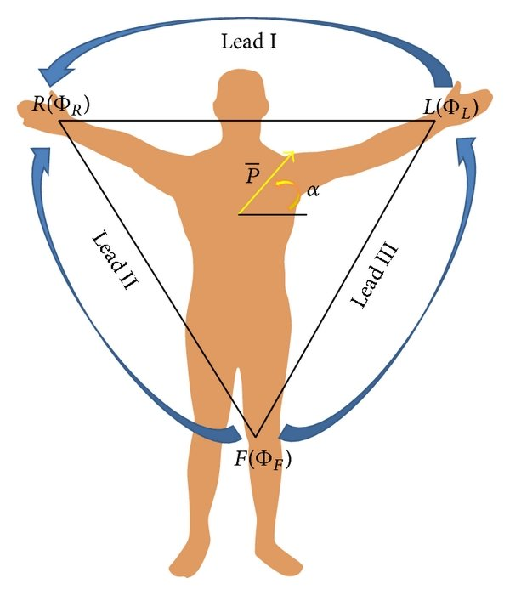
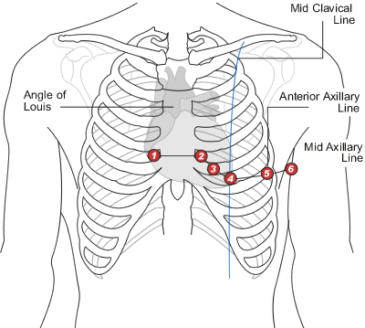
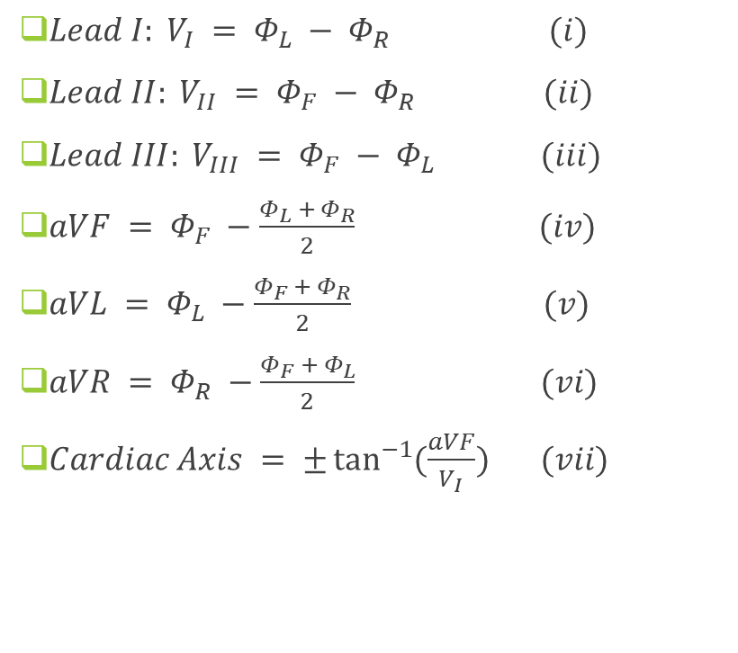
Working Principle
$Lead I: V_{I} = Φ_{L} − Φ_{R} (i)$
$Lead II: V_{II} = Φ_{F} − Φ_{R} (ii)$
$Lead III: V_{III} = Φ_{F} − Φ_{L} (iii)$
$aVF = Φ_{F} −\frac{Φ_{L} + Φ_{R}}{2}$ $(iv)$
$aVL = Φ_{L} −\frac{Φ_{F} + Φ_{R}}{2}$ $(v)$
$aVR = Φ_{R} −\frac{Φ_{F} + Φ_{L}}{2}$ $(vi)$
$Cardiac Axis = ±\tan^{−1}{(\frac{aVF}{V_{I}})} (vii)$
ECG Electrode placement and potential
Source:aimcardio.com

Slide 14
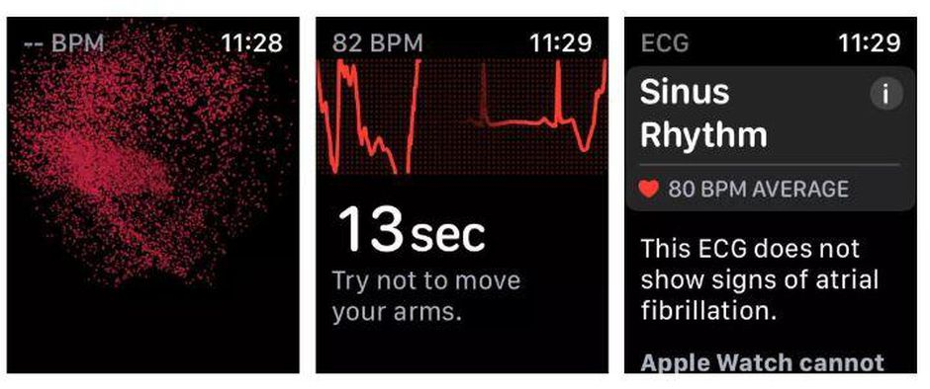
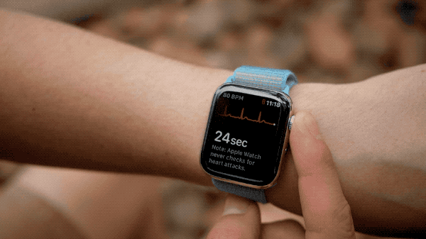
Case Study (Apple’s Single Lead ECG Watch)
Pros
Approximately takes 30 seconds of wait time.
Results on ECG app
Circuit is completed by toughing left and right arm we can get only single Lead
ECG graph and anticipated findings are displayed on an ECG application running on an Apple iPhone.
Can detect sinus rhythm ( or normal rhythm consistent 50-100 BPM) and atrial fibrillation can be detected using a single-lead ECG.
Claims about 98% accuracy of Atrial Fibrillation detection.
Cons
Can only get single lead ECG
Wet contact or body in motion can alter results
Cannot detect other heart issues
Apple’s ECG Watch
Source: apple.com

Slide 15
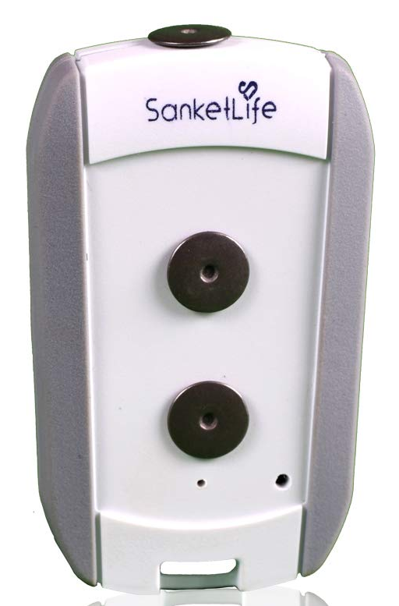
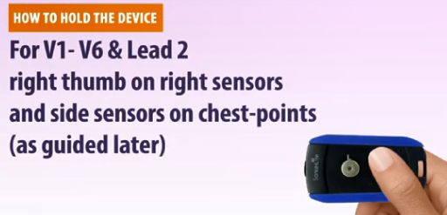
Case Study (Sanket’s 12 Lead ECG)
Pros
Sanket's ECG is small portable ECG device that is widely used in rural markets.
Cheap and no need for additional wired electrode placements.
Can record 12 Lead ECG signal
Has total of 2 electrode contact point system, which are touched at different body parts to get a single lead ECG
Completing different circuits we can get all 12 Leads ECG using it
Cons
Needs assistance of a medical practitioner to use it
Misplacement of electrode may result in improper results
Better noise deduction can be obtained
Sanket’s 12Lead ECG
Source:sanketlife.in

Slide 16
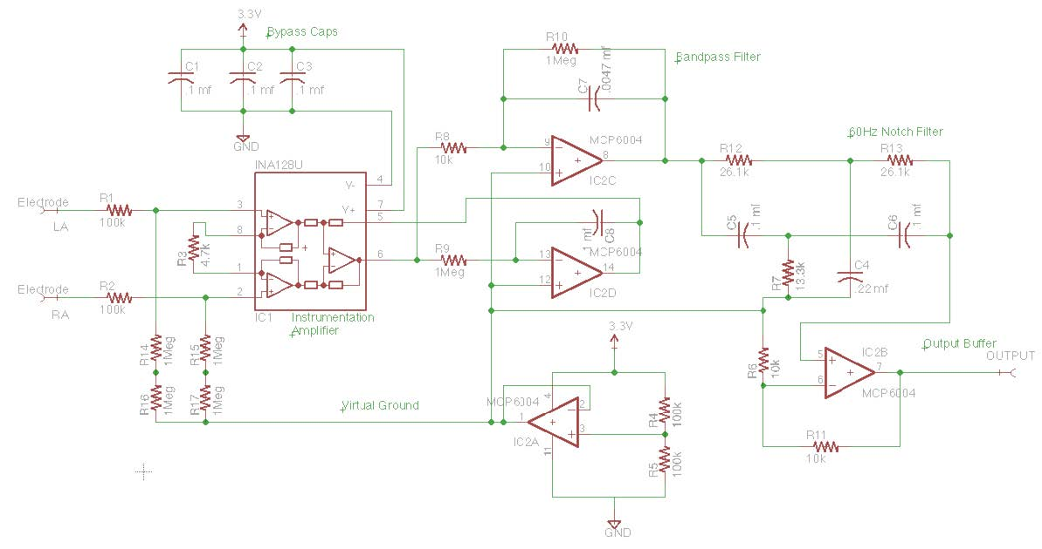
Case Study (Sanket’s 12 Lead ECG)
Total of 2 electrode system
When touched at different body parts using electrodes circuit completes and single lead ECG is recorded
Completing different circuits we can get all 12 Leads ECG using it
Circuit contains electrodes, a bypass capacitor (removes DC noise), amplifier (to amplify lower signals), bandpass filter circuit and a notch filter to remove noise and tune the ECG recording
Circuit Diagram
Source: CSE 474 courses.cs.washington.edu

Slide 17
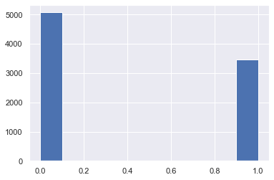
Dataset Refining
Taken a sample dataset from “AliveCor's Short Single Lead ECG Recording” dataset
Dataset contained 2001 columns and 8530 rows
Columns from 1st to 2000th are times in seconds and 2001th column is string labeled column as Normal or Atrial Fibrillation datapoints.
Each Row denotes Amplitudes value in mV taken at different time frames and labeled as Normal or Abnormal
No missing or null data points
Converted the label column to 0 (normal) and 1 (atrial fibrillation).
Skewness check was done by plotting histogram on counts of occurrence of 0(58% dataset) and 1.
Shuffled the dataset and divided it into training and validation testing.
Histogram showing Normal and Abnormal datapoints

Slide 18
Dataset Modelling
Time Signals | 0 | 1 | 2 | 3 | 4 | 5 | 6 … | 1999 | Label
Row 1 | 0.035032 | 0.037155 | 0.044586 | 0.063694 | 0.076433 | 0.085987 | 0.089172 | -0.02229 | Normal
Row 2 | -0.03529 | -0.03257 | -0.03094 | -0.02986 | -0.03149 | -0.0342 | -0.03746 | 0.001086 | Normal
Row 3 | -0.30392 | -0.26144 | -0.22222 | -0.19281 | -0.17647 | -0.1634 | -0.14706 | -0.06536 | Normal
Row 4 | 0.109467 | 0.117604 | 0.128698 | 0.142012 | 0.153107 | 0.161982 | 0.170118 | 0.013314 | Abnormal
Row 5 | -0.01986 | -0.01715 | -0.01444 | -0.01173 | -0.00993 | -0.00812 | -0.00632 | 0 | Abnormal
Row 6 | 0.051136 | 0.0625 | 0.090909 | 0.142045 | 0.238636 | 0.335227 | 0.4375 | 0.119318 | Normal
Row 7 | -0.12387 | -0.12991 | -0.13595 | -0.14804 | -0.16012 | -0.17221 | -0.18429 | 0.253776 | Normal
Row 8 | -0.04615 | -0.0441 | -0.04205 | -0.03897 | -0.0359 | -0.03179 | -0.02769 | 0.019487 | Abnormal
Row 9 | -0.02503 | -0.02503 | -0.02253 | -0.01877 | -0.01126 | 0.001252 | 0.017522 | -0.0776 | Abnormal
Table 1 Sample ECG Alivecor short single lead dataset

Slide 19
Dataset Modelling
From dataset, there is no correlation between any two columns and every column is important
Our features are the time valued columns with equal weights and labelled column as out predicting column.
Each row seems as an image matrix so this seemed as an image classification problem
To predict image we chose to build a Convolution Neural Network model
As CNN works better in a sharp object and edge detections techniques.
Single Row ECG Plot

Slide 20
Dataset Modelling
Each row is represented as 1D matrix of an ECG image .
Divided dataset into 80% as training and 20% as validation set.
Chose kernel size (length of one-dimensional convolution window) as 5.
Filter size (output space's dimensionality). As we need to check different parts of the image searching for datapoints.
Input layer shape for ConvNet was used to be (2000x1).
Model consists of 8 ConvNet hidden layers (ReLu),1 flattened output layer (sigmoid) and then performed max pooling, dropouts(5th,7th and 8th layer), and dense layers.
Max pooling is used to get maximum value in each patch of feature map, highlights most abundant feature in patch.
Use of dropouts, where randomly chosen neurons are ignored during training, their contribution to activation of downstream neurons is removed temporally during forward trip, and any weight modifications to neuron are skipped during backward pass.
Utilized Adam Optimizer with learning rate of 0.00006, with total of 100 epochs and batch size of 128.
On the basis of loss, accuracy, precision, we evaluated our model, using python libraries of TensorFlow, Keras and Scikit-Learn

Slide 21
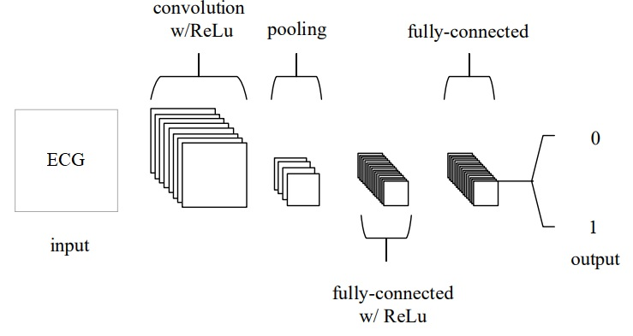
Dataset Modelling
Convolution Neural Network

Slide 22
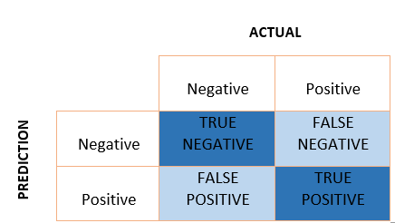
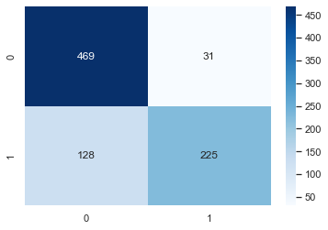
Results and Discussion
To better represent normal and abnormal ECGs, we renamed the designated column 0 and 1
Determining that dataset is not skewed.
Built a deep learning Convolution Neural Network (CNN) model with 100 epochs and 128 batch size.
Assessed the model over the dataset after fitting, was able to get an 81.36 % accuracy and loss about 44.8%
Constructed the confusion matrix and estimated the precision, recall, and F1 score.
Confusion Matrix

Slide 23
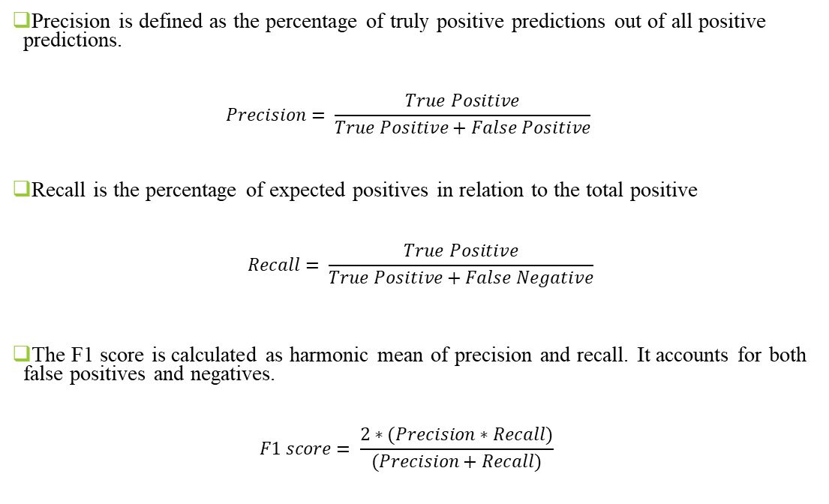
Results and Discussion
Precision is defined as the percentage of truly positive predictions out of all positive predictions.
$$Precision= \frac{True Positive}{True Positive+False Positive}$$
Recall is the percentage of expected positives in relation to the total positive
$$Recall= \frac{True Positive}{True Positive+False Negative}$$
The F1 score is calculated as harmonic mean of precision and recall. It accounts for both false positives and negatives.
$$F1 score= \frac{2∗(Precision∗Recall)}{(Precision+Recall)}$$
 | Precision | Recall | F1 score
Normal | 0.79 | 0.94 | 0.86
Atrial Fibrillation | 0.88 | 0.64 | 0.74
Table 2 Precision, Recall, F1 score

Slide 24
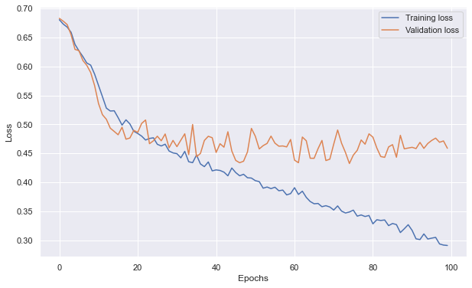
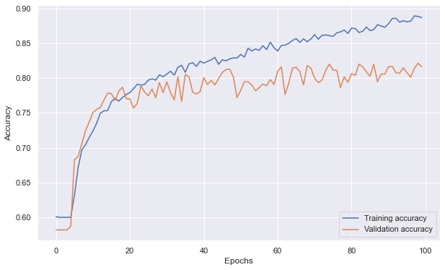
Results and Discussion
Loss v/s Epochs for Training Loss and Validation Loss
Accuracy v/s Epochs for Training Accuracy and Validation Accuracy

Slide 25
Conclusion
Learned how our hearts operate and how an electrocardiogram works, as well as which risk factors may be detected using an electrocardiogram. We also learned about the different types of heart disease.
Learnt about the products that are available in market, and need of making the move from traditional to cheap portable devices.
Analyzed about procedures of taking an traditional electrocardiogram.
Studied parts of ECG waves and different sections like P-wave, QRS-complex, T-wave, etc.
Studied how a convolutional neural network model can be built and how it can be used to effectively predict Atrial Fibrillation.
Measure of accuracy, precision and recall of our model.
Learnt about micropattern electrodes, which can be used to improve the accuracy, grip and precision.
Following this, we can proceed for portable, point-of-care ECG device setup and own data collection.

Slide 26
References
Design of ECG Homecare:12-Lead ECG Acquisition using Single Channel ECG Device Developed on AD8232 Analog Front End
Accessing the ECG Data of the Apple Watch and Accomplishing Interoperability Through FHIR (researchgate.net)
Taking an ECG with the ECG app on Apple Watch Series 4, Series 5, or Series 6 - Apple Support (IN)
CSE 466 Lab 7: Analog Front End for an Electrocardiograph (washington.edu)
CSE466 lectures (washington.edu)
True Unipolar ECG Machine for Wilson Central Terminal Measurements (researchgate.net)
A Novel Wearable Device for Continuous Ambulatory ECG Recording: Proof of Concept and Assessment of Signal Quality (nih.gov)
Electronics | Free Full-Text | Advances of ECG Sensors from Hardware, Software and Format Interoperability Perspectives (mdpi.com)
Comparison of Baseline Wander Removal Techniques considering the Preservation of ST Changes in the Ischemic ECG: A Simulation Study (hindawi.com)
Passive Detection of Atrial Fibrillation Using a Commercially Available Smartwatch | Atrial Fibrillation | JAMA Cardiology | JAMA Network
Comparison of Baseline Wander Removal Techniques considering the Preservation of ST Changes in the Ischemic ECG: A Simulation Study (hindawi.com)

